Slide 1
Advanced Customer Analytics: Segmentation, Customer Churn and Predictive Marketing model
BIA 686-A
Practicum In Analytics
Final Project
Guided by:
Dr. Chris Asakiewicz
Group – 7
Revanth Vemula
Harshil Chauhan
Raghava Sagar

Slide 2
Business Problem
Business Questions
A retail company wants to improve its customer engagement and retention strategy to increase revenue and customer loyalty.
The company wants to leverage this data to segment its customers, predict their likelihood of churning, and design targeted retention strategies to address the specific needs and preferences of high-risk customers.
How can we segment customers based on their demographic, socioeconomic, and purchasing behavior attributes?
Which customers are at high and low risk of churning?
How to predict the response of future marketing campaigns?

Slide 3
Dataset
The dataset originally found on Kaggle, provided to the owner by Dr. Omar Romero-Hernandez.
29 Columns with attributes divided into categories like People, Product, Promotion, Place.
2240 rows of data where each row gives information about one customer.
It has few missing values that need to be handled before performing any analysis.
The dataset has limited information about customers purchasing behavior, promotional campaigns which had impact the accuracy of the predictive models.
Dataset: https://www.kaggle.com/datasets/imakash3011/customer-personality-analysis
Columns Description
People: Includes Id, birth date, education, income, marital status, Customer data, etc.
Products: Includes amount spent on wines, fruits, meat, fish, sweet and gold product categories in last 2 years
Promotions: Number of times different types of promotions used, Number of purchases made with a discount, response.
Place: Which platform was used to purchase product (store, web, catalog) and No. Of web visits

Slide 4
Building Strategy
We chose the following approaches based on common industry practices and techniques in data analytics:
Customer Segmentation, Churn Prediction and Customer Retention Strategy:
Use RFM analysis and clustering techniques to segment customers based on relevant attributes.
Utilize machine learning algorithms to classify customers as high or low churn risk.
Design targeted retention strategies based on the model's results and the specific needs of high-risk customers.
Targeted Marketing Campaign Optimization:
Analyze response rates of previous campaigns to optimize marketing efforts.
Utilize machine learning algorithms to predict future campaign responses.

Slide 5
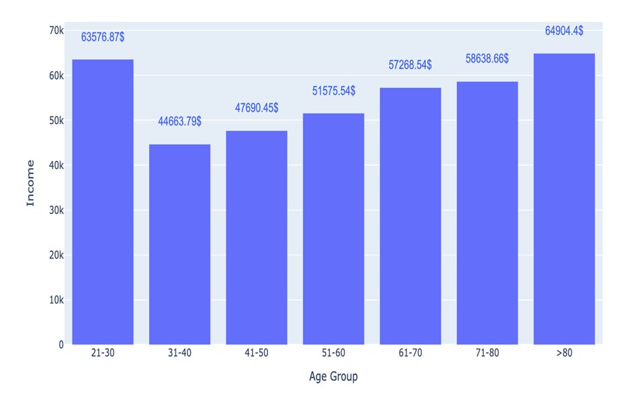
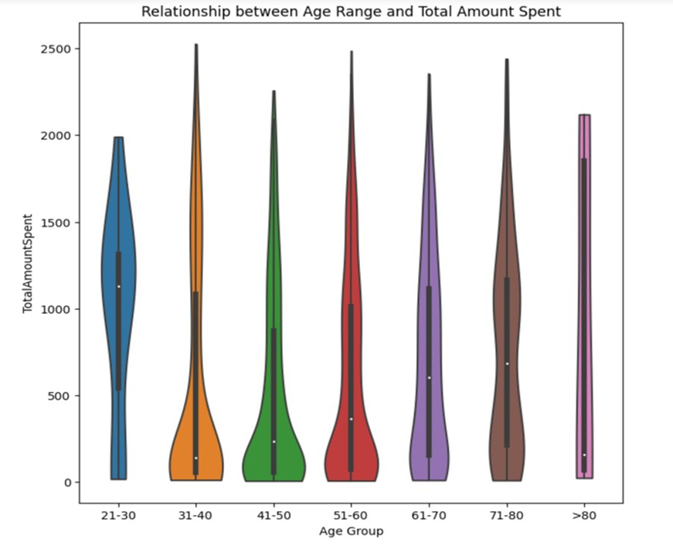
Exploratory Data Analysis
Age Vs Income
Age Vs Amount Spent
Notes:
Age vs Income
>80 customers earn the highest income, followed by 21-30 group.
Income alone may not be a reliable predictor of how much someone will spend.
Age Vs Total Amount Spent
Customers are segmented by age into 7 groups.
More expenditure is done by 21- 30 age group averaging $1127.
Outliers are seen in all age ranges. With >80 having the most.

Slide 6
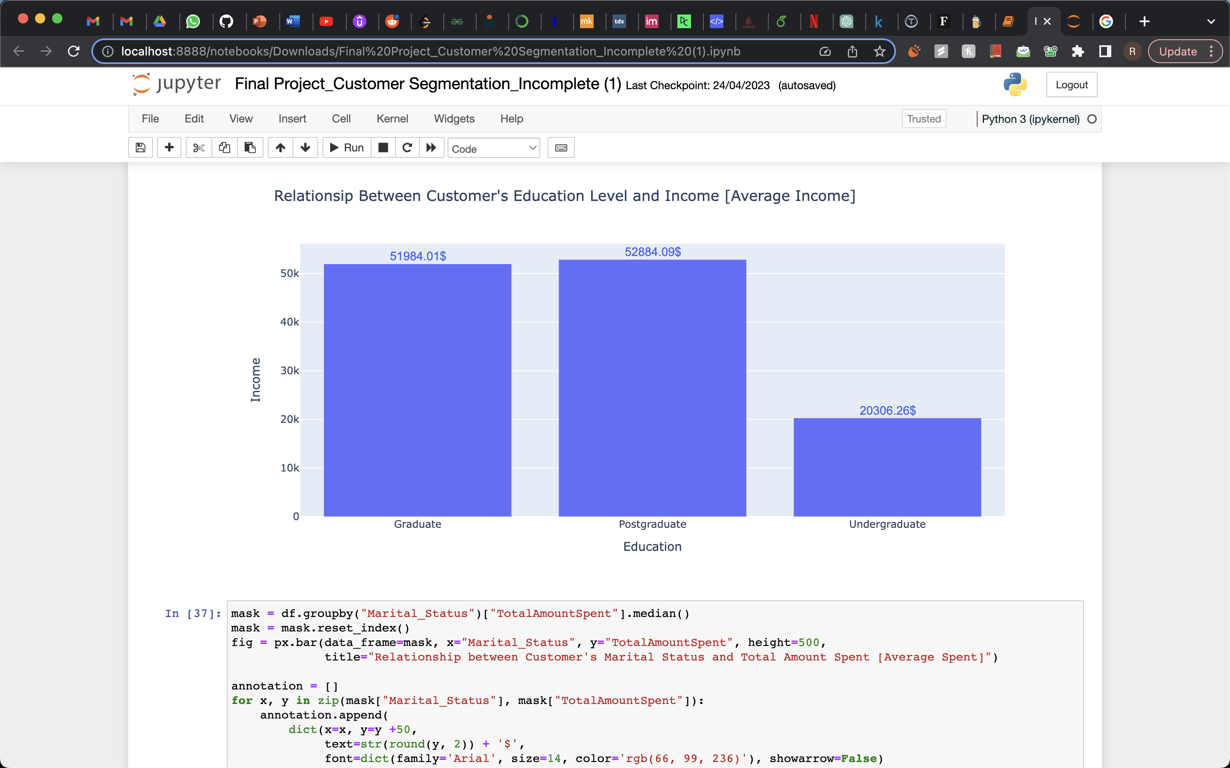
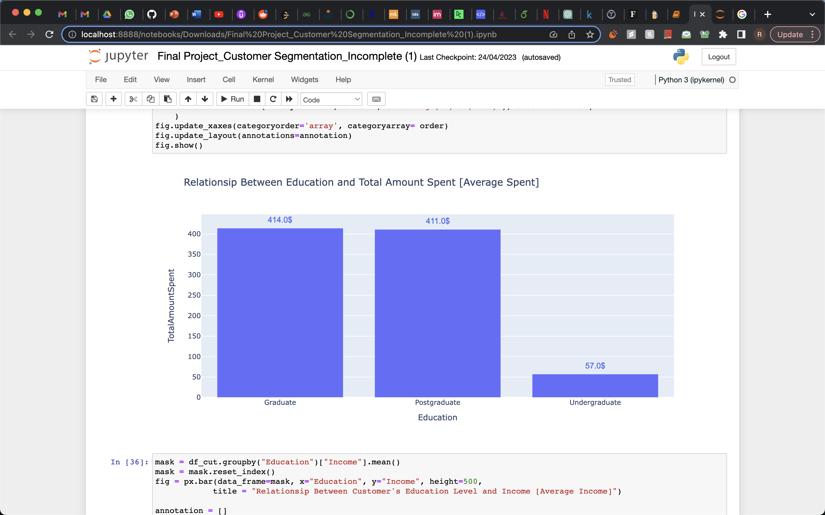
Exploratory Data Analysis
Education vs Income
Education Vs Amount Spent
Notes:
•Spending by Graduates and Postgraduates are almost equal in amount.
•Average spent by undergrads is almost 7 times lesser when compared to others.

Slide 7
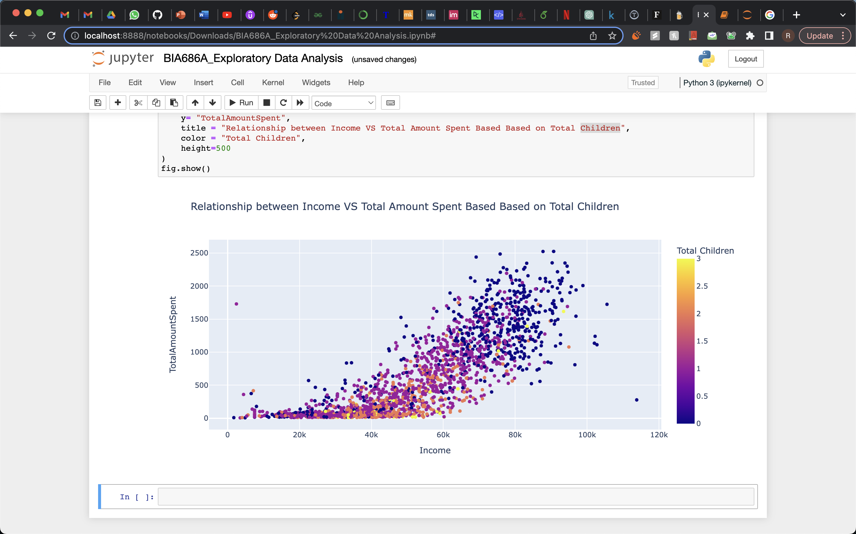
Exploratory Data Analysis
Notes:
In terms of total children and total amount spent. We saw that on average there was a decline on the amount spent as the total number of children increases.I.e, as children increases so do the amount spent on average reduces.

Slide 8
Methodology – Clustering
K-means clustering was used to cluster the data based on demographic and behavioral values.
K-means clustering by including 2 and 3 variables respectively were done to find optimum cluster for low-risk customers and high-risk customers.
Elbow method used to find optimal number of clusters. I.e., 3.
Interpreting Result:
Cluster 1 depicts young customers that earn way lot and spend a lot.
Cluster 2 translates to old customer that earn lot and spend high.
Cluster 3 depicts young customers that earn lows and spend low.

Slide 9
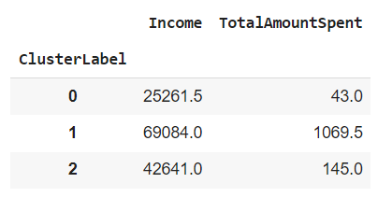
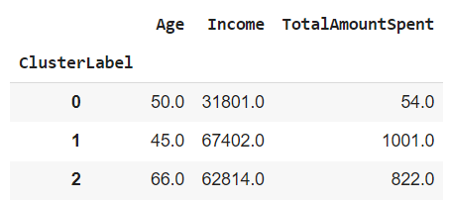
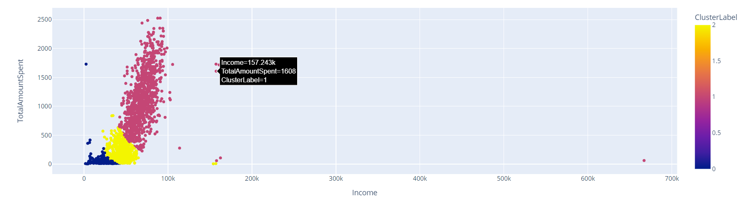
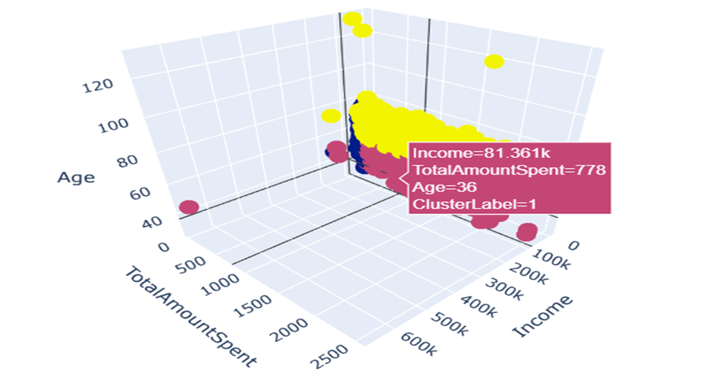
K- Means Model using Two and Three Features

Slide 10
Dataset Highlights - Exploratory Data Analysis
Income is one of the key indicator used to determine the amount a customer would spend.
Customers with graduate education and above tends to spend 12 times higher than other customers.
Married customers spends more considering they have a family to take care of.
Segmented customers based on demographic and behavioral data, helps in enabling personalized marketing campaigns that cater to the specific needs and interests of each customer segment
Average spending range for each product is about $0-200.

Slide 11
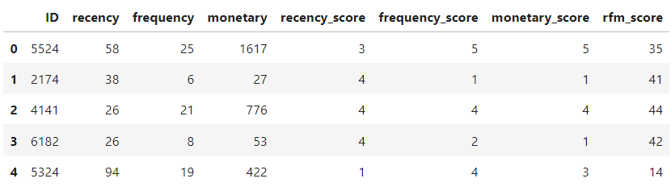
Methodology – RFM Analysis
RFM analysis is a way to use data based on existing customer behavior to predict how a new customer is likely to act in the future. RFM stands for Recency, Frequency and Monetary.
The dataset consists of the column recency, frequency (considered by num of total purchases) and monetary by total amount spend.
Each of them are given scores from 1 – 5, and a final RFM score is calculated by adding weighted average of individual RFM score by ID.
This RFM score is then used to determine segments of customers.

Slide 12
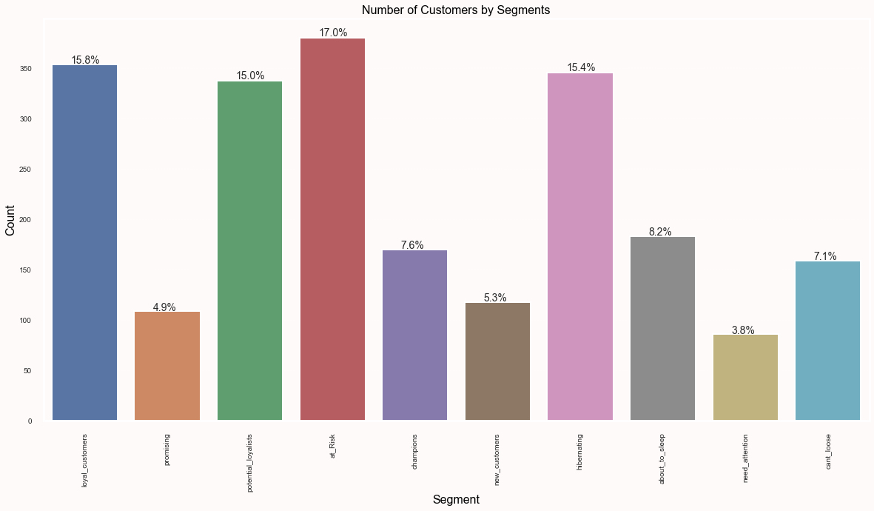
RFM Analysis

Slide 13
Segment​ | Description​ | Percentage​
r'5[4-5]'​ | Champions: Bought recently, buy often and spend the most.​ | 7.6%​
r'[3-4][4-5]'​ | Loyal Customers: Spend good money with us often. Responsive to promotions.​ | 15%​
r'[4-5][2-3]'​ | Potential Loyalist: Recent customers but spent a good amount and bought more than once.​ | 15%​
r'51'​ | New Customers: Bought most recently, but not often.​ | 5.3%​
r'41'​ | Promising: Recent shoppers but haven’t spent much.​ | 4.9%​
r'33'​ | Need Attention: Above average recency, frequency and monetary values. May not have bought very recently.​ | 3.8%​
r'3[1-2]'​ | About To Sleep: Below average recency, frequency and monetary values. Will lose them if not reactivated.​ | 8.2%​
r'[1-2][3-4]'​ | At Risk: Spent big money and purchased often. But long time ago. Need to bring them back.​ | 17%​
r'[1-2]5'​ | Can’t Lose Them: Made biggest purchases, and often. But haven’t returned for a long time.​ | 7.1%​
r'[1-2][1-2]'​ | Hibernating: Last purchase was long back, low spenders and bought seldomly.​ | 15.4%​

Slide 14
Highlights – RFM Analysis
Increase loyalty and customer engagement - Use timely promotions and instructive content to stay in touch with recent or new clients. This will certainly boost their engagement with the company.
Decrease churn - Send personalized communications to customers in at risk, need attention, and about to sleep segments; provide discounts for regular customers, or offer surveys that assist in identifying and addressing any issues.
Reduce marketing costs - Reduce costs by focusing quickly and easily on smaller segments that are more likely to produce revenue and use insights from RFM analysis to optimize campaigns going forward. For customers in segment of at risk, need attention, and can't lose them.

Slide 15
Methodology and Highlights – Churn Prediction
To support the outcomes of RFM analysis, we use churn prediction scenario using logistic regression which helps us to predict customers at high risk and low risk churning.
Recency, Income and Complain were used as feature columns.
We found that customers in the "at_Risk", "hibernating", and "need_attention" segments.
The "at_Risk" segment has a high risk of churn, with a predicted churn rate of 47%.
The "hibernating" segment has a medium risk of churn, with a predicted churn rate of 24%.
The "need_attention" segment also has a medium risk of churn, with a predicted churn rate of 27%.
On the other hand, the "champions", "loyal_customers", and "potential_loyalists" segments have a low risk of churn, with predicted churn rates of 0.99%, 12%, and 12%, respectively.

Slide 16
Retention Strategies
For the "at_Risk" segment, we can offer personalized incentives and promotions to encourage them to make a purchase soon.
For the "hibernating" segment, we can send reminder emails or push notifications about new products or promotions to encourage them to re-engage with our brand.
For the "need_attention" segment, we can offer targeted promotions or discounts to incentivize them to make a purchase and stay engaged with our brand.

Slide 17
Methodology – Predicting Campaign Response
Analyzed the response rates of previous campaigns for each cluster to optimize targeted marketing efforts. Basically, using marketing campaign data as feature columns.
Utilized machine learning algorithms (e.g., logistic regression, smote, xgboost, or random forest) to predict the likelihood of customers accepting offers in future campaigns based on their historical campaign response behavior and cluster membership.
Precision of each model is prediction for positive responses while recall is actual positive response.
Model's accuracy is shown by F1 score - a harmonic mean of precision and recall values.

Slide 18
Calculating Accuracy
Accuracy of models was assessed using metrics such as accuracy, precision, recall, and F1-score.
Logistic regression model had the highest accuracy and weighted F1 score among all models.
To further see an improvement in the performance metrics, we have applied SMOTE and retrained the logistic regression model.
Random forest model had the highest precision for the positive class among all models, making it best for identifying positive responses.
Notes:
(1) The data is imbalanced which why a harmonic mean of 2 features is calculated i.e. F1 score

Slide 19
Results
Regression Models | Accuracy | Precision (Class 1) | Recall (Class 1) | F1-Score (Class 1) | Assessment
Logistic Regression (Unbalanced) | 85% | 0.50 | 0.16 | 0.24 | Moderate ability to predict positive responses
Logistic Regression (SMOTE) | 79.5% | 0.34 | 0.48 | 0.40 | Improved performance for class 1 instances
XGBoost | 79% | 0.33 | 0.45 | 0.38 | Moderate ability to predict positive responses
Random Forest classifier | 80% | 0.34 | 0.45 | 0.38 | Moderate ability to predict positive responses
Notes:
The models discussed (logistic regression, SMOTE, XGBoost, and Random Forest) all show moderate performance in predicting positive campaign responses based on previous campaign response rates and may require more campaign data for further analysis and optimization to improve accuracy, precision, and recall.
Overall, these metrics suggest that the logistic regression model is not perfect, but it can still be useful in identifying customers who are more likely to respond positively to the promotional campaign.
However, Random forest model has the highest precision and relatively high recall for positive response.

Slide 20
Analysis Highlights – Regression models
The logistic regression model has the highest accuracy (0.85) and weighted F1 score (0.81) among all the models.
If the focus is on identifying positive responses (i.e., customers who are likely to accept the offer), the random forest model has the highest precision for the positive class (0.34) among all the models.
Therefore, If the priority is to maximize the precision for positive responses, the Random Forest model may be the best choice.
On the other hand, if the goal is to have the highest overall accuracy and F1 score, the Logistic Regression model may be more suitable.
Notes:
it's important to note that the performance of the models may vary depending on the specific business requirements and constraints.

Slide 21
Conclusion
Exploratory data analysis on demographics, Income and Spending amount can help to understand the data and segment the customers using K means Clustering technique.
RFM analysis is done to identify customers who are most valuable to the business and those who are at risk of churning. This is again supported by Churn analysis done by logistic regression helping in predicting the customers who are at risk of Churning.
Output of RFM Analysis is used to segment customers and implement retention strategies.
Logistic regression, SMOTE, XGBoost, and Random Forest models were used to predict future campaign responses based on previous response rates. Logistic regression performed the best overall. Further analysis and optimization could improve model performance.
Overall, the business can use these insights to optimize their marketing and retention strategies, increase customer satisfaction, and improve their bottom line.

Slide 22
References
Dataset - https://www.kaggle.com/datasets/imakash3011/customer-personality-analysis
"Customer Segmentation Using K-means Clustering" by Towards Data Science: https://towardsdatascience.com/customer-segmentation-using-k-means-clustering-d33964f238c3
"Predictive Customer Retention: How to Keep Your Customers Using Machine Learning" by DataCamp: https://www.datacamp.com/community/tutorials/predictive-customer-retention-machine-learning
What is RFM Analysis? - https://www.actioniq.com/blog/what-is-rfm-analysis/

Slide 23
Thankyou!

